Slide 1
Image Pyramids
patrick Kevorkian

Slide 2
Topics
Gaussian Pyramids
Laplacian Pyramids
Pyramid Blending
Composite Blending

Slide 3
Goals
To understand the Gaussian Pyramid
To understand the Laplacian Pyramid
Use these concepts practically
Implement these practicalities

Slide 4
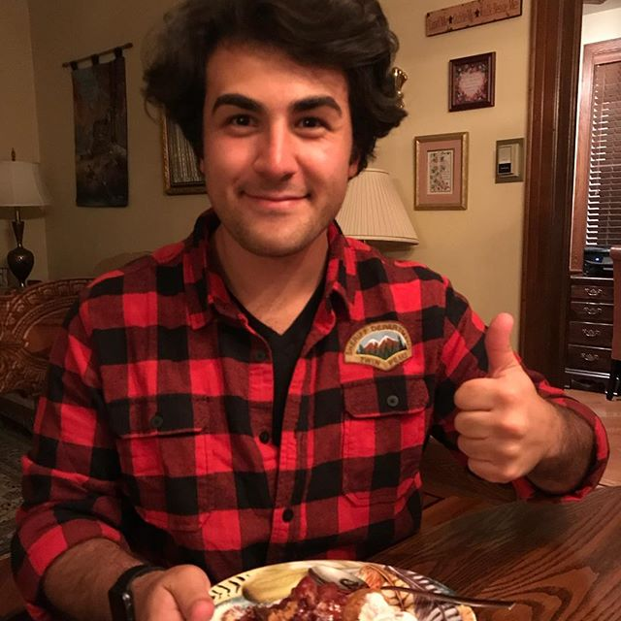

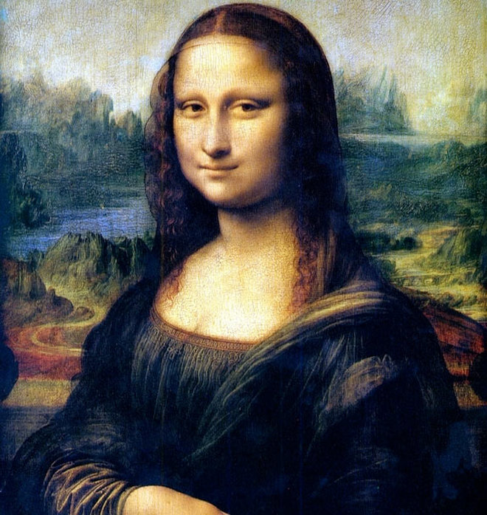


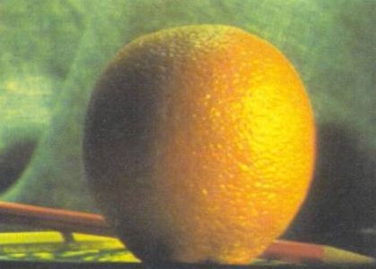
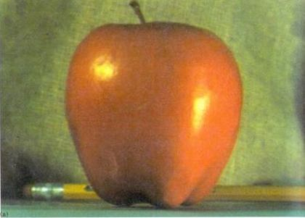
Review original images

Slide 5
Gaussian Pyramid
code: Me in python
Series of down sampling
Series of Blurring
Remove every other col/row
Gaussian blur
Results in smaller and smaller images (hence pyramid)
Halves each time

Slide 6
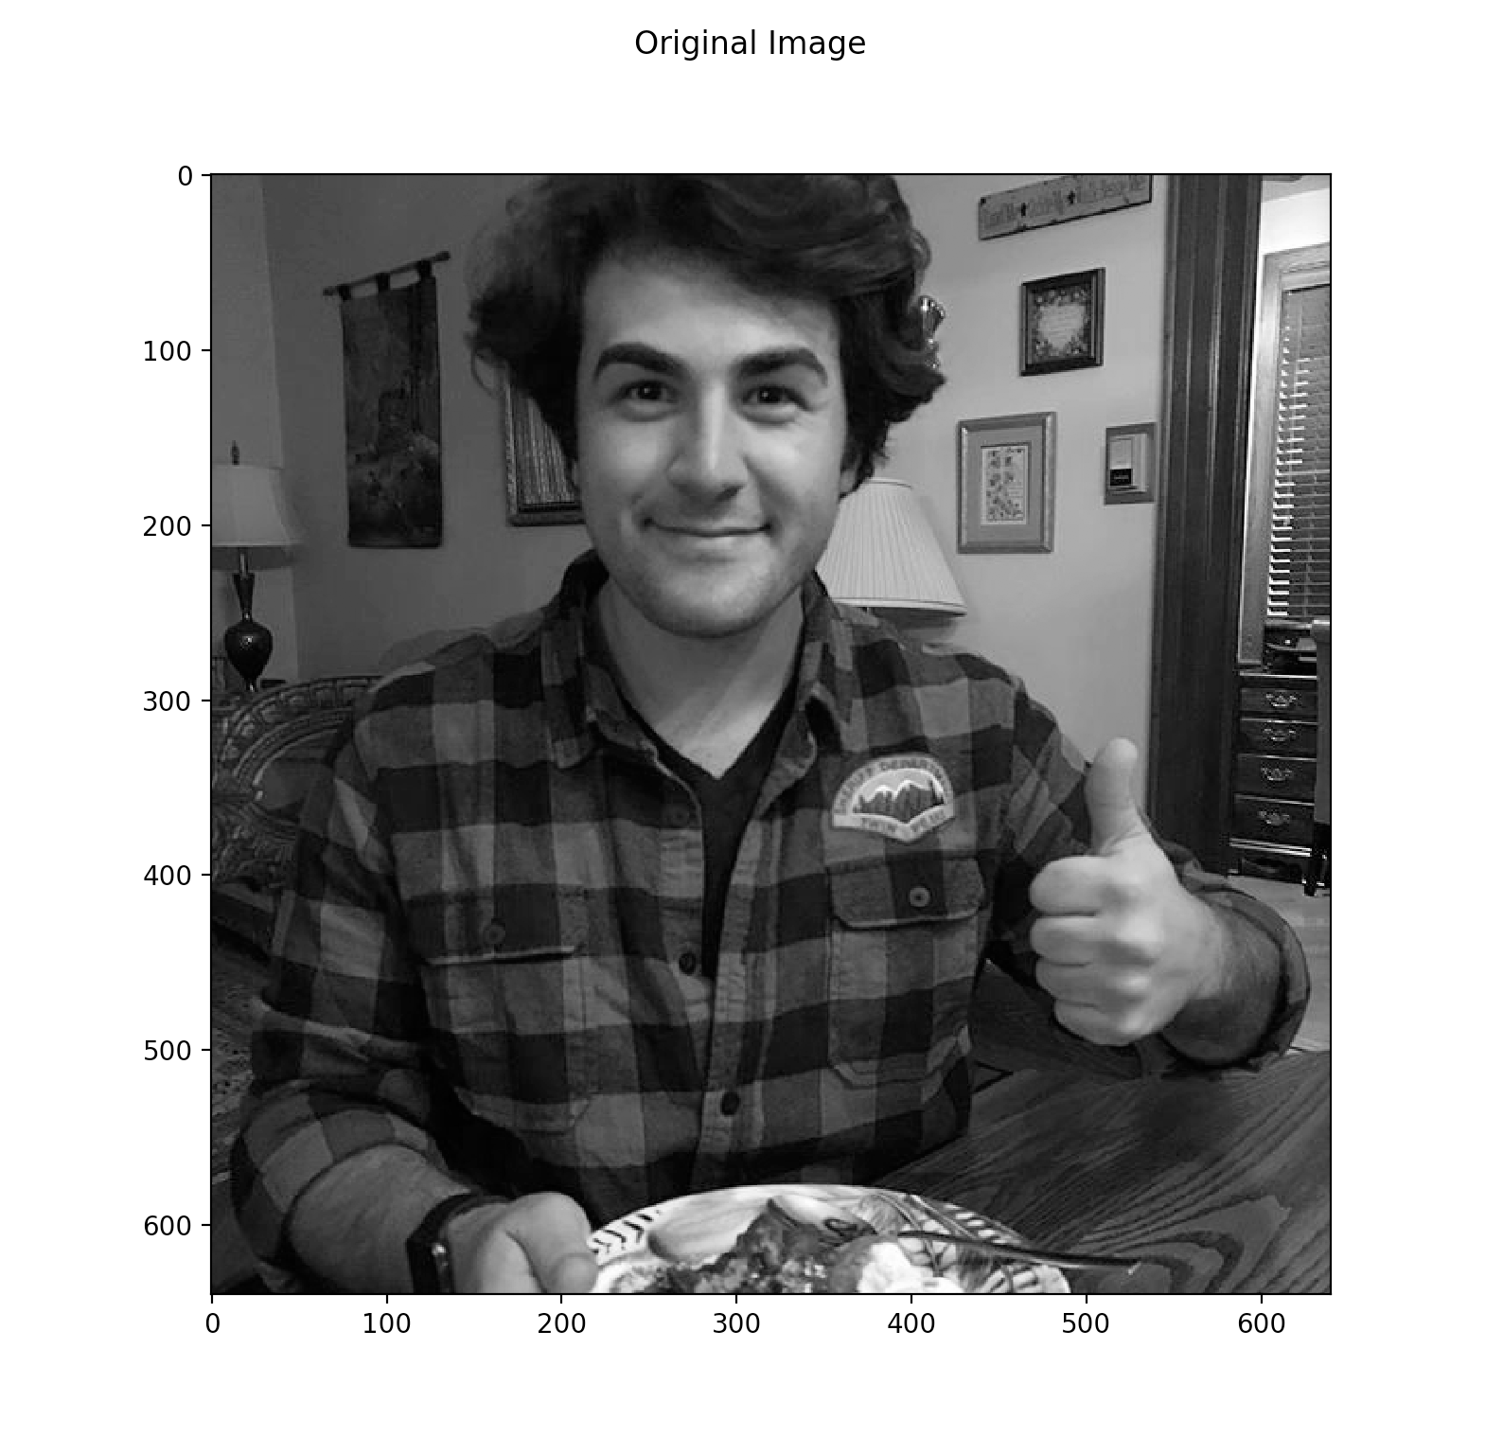
Example 1: ME
Pyr: 0

Slide 7
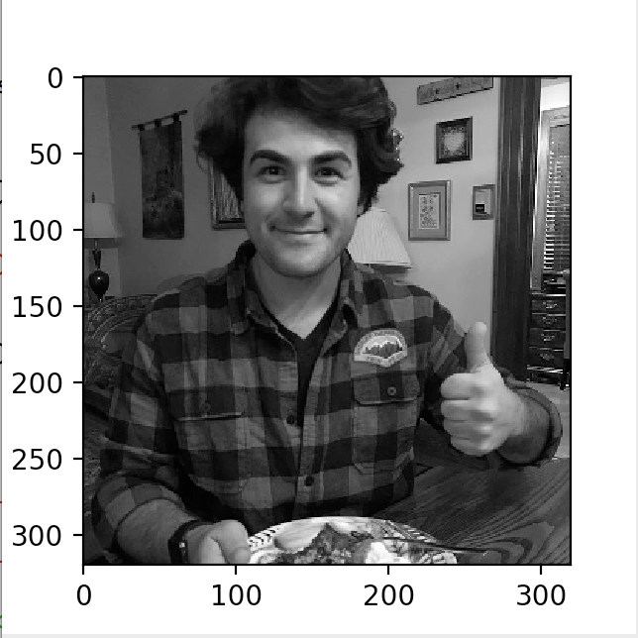
Example 1: me
pyr: 1

Slide 8
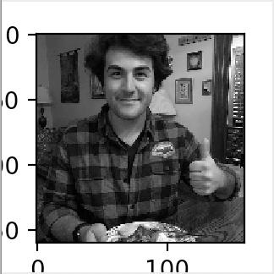
Example 1: me
Pyr: 2

Slide 9
Example 1: me
All Together

Slide 10
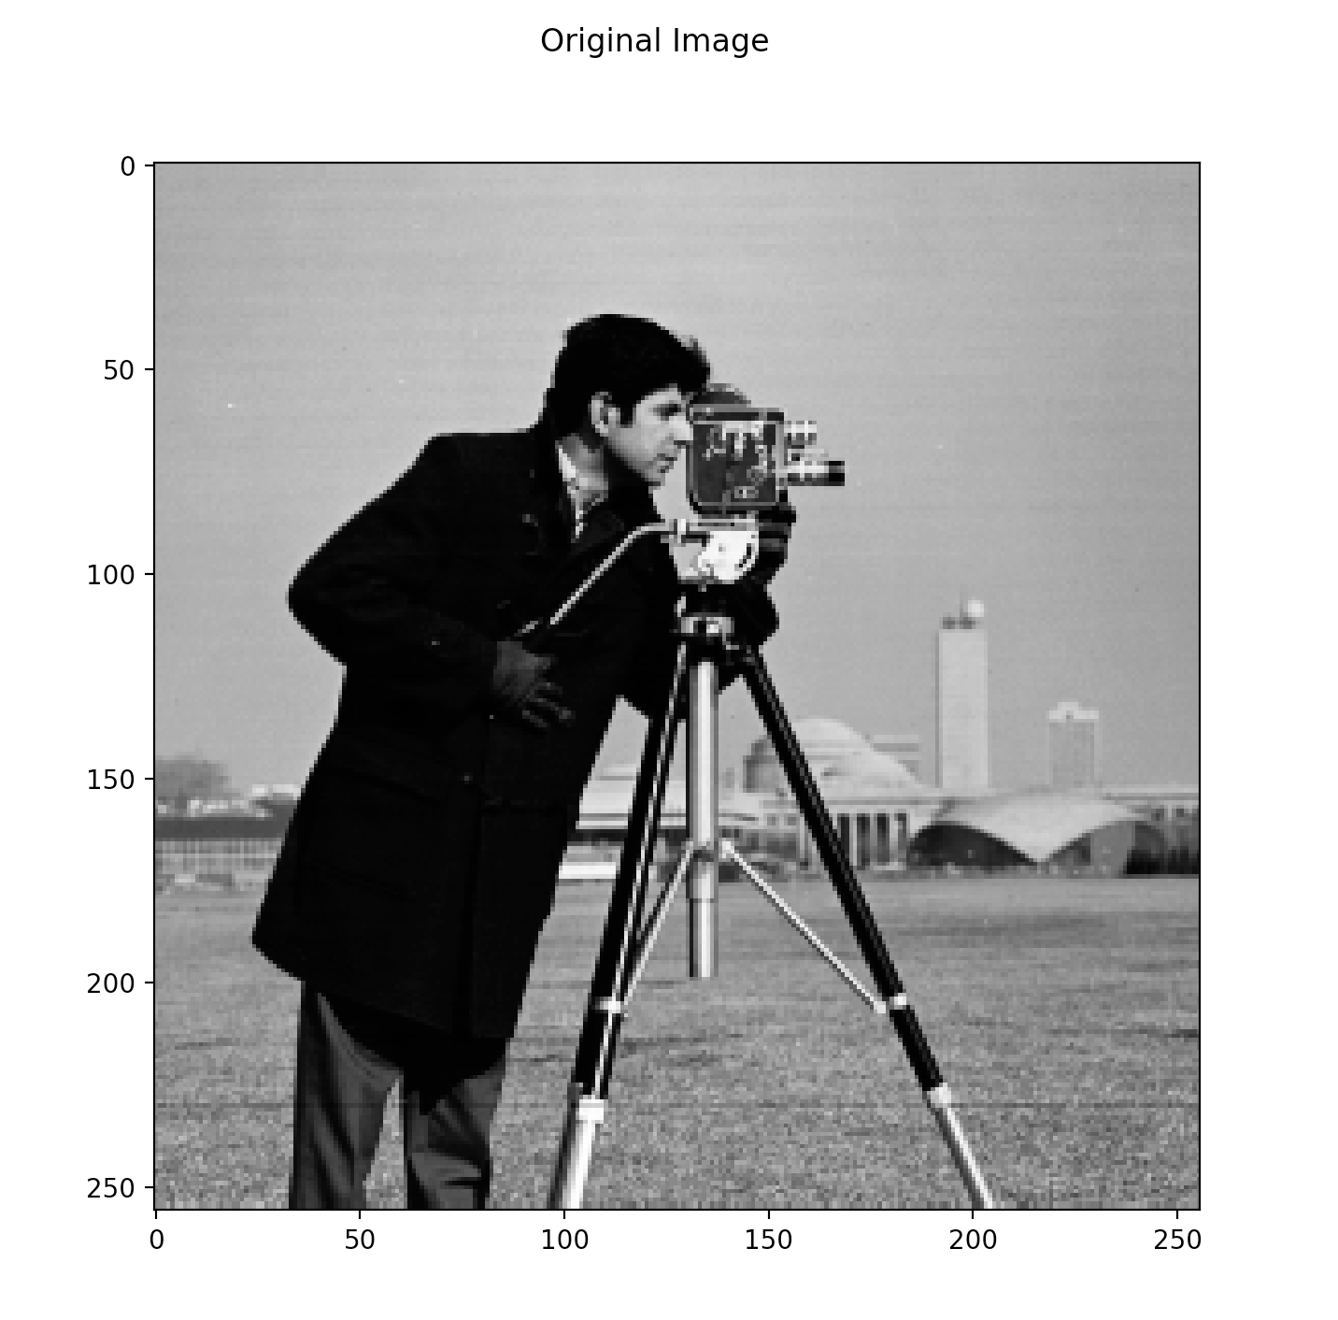
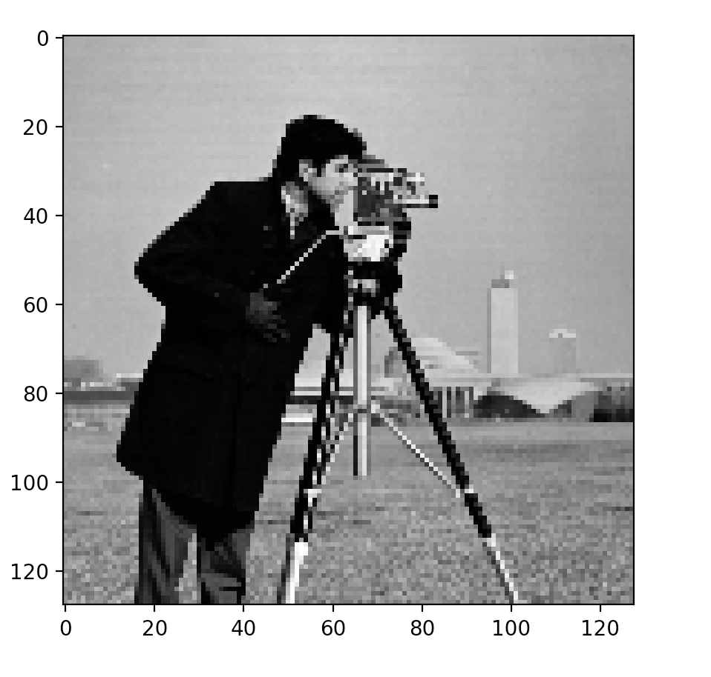
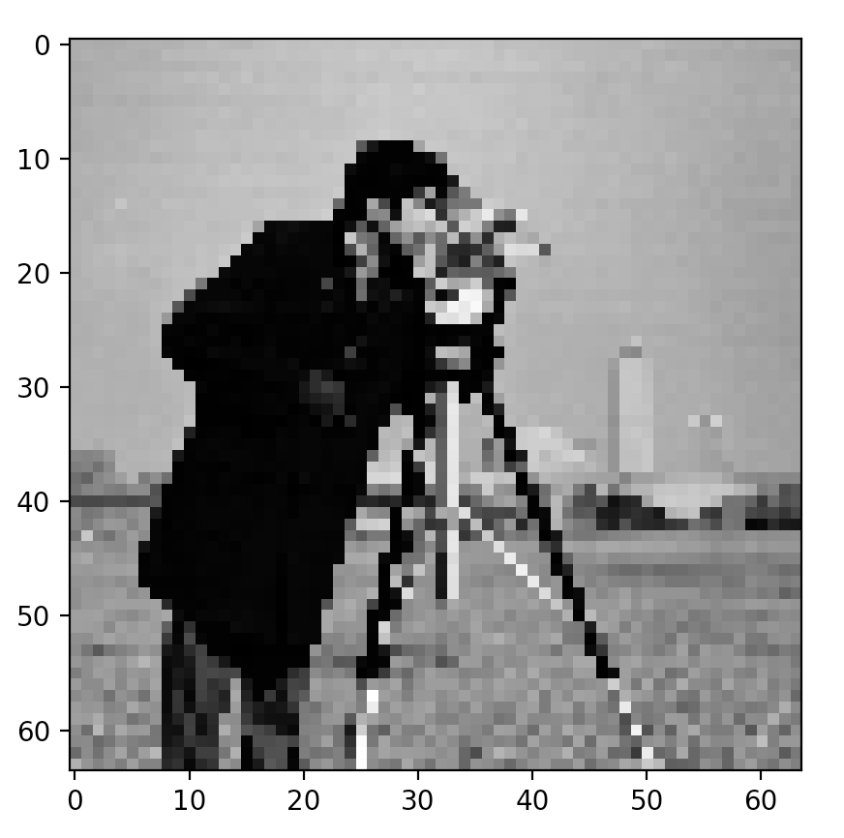
Example 2: camera man
All together

Slide 11
Laplacian Pyramids
code: me in python
Based from Gaussian
Subtract blurred image from original = Lap image
Able to retain images details that are lost
Reconstruct image
Upscaling
Upscale + Lap image = next level up

Slide 12
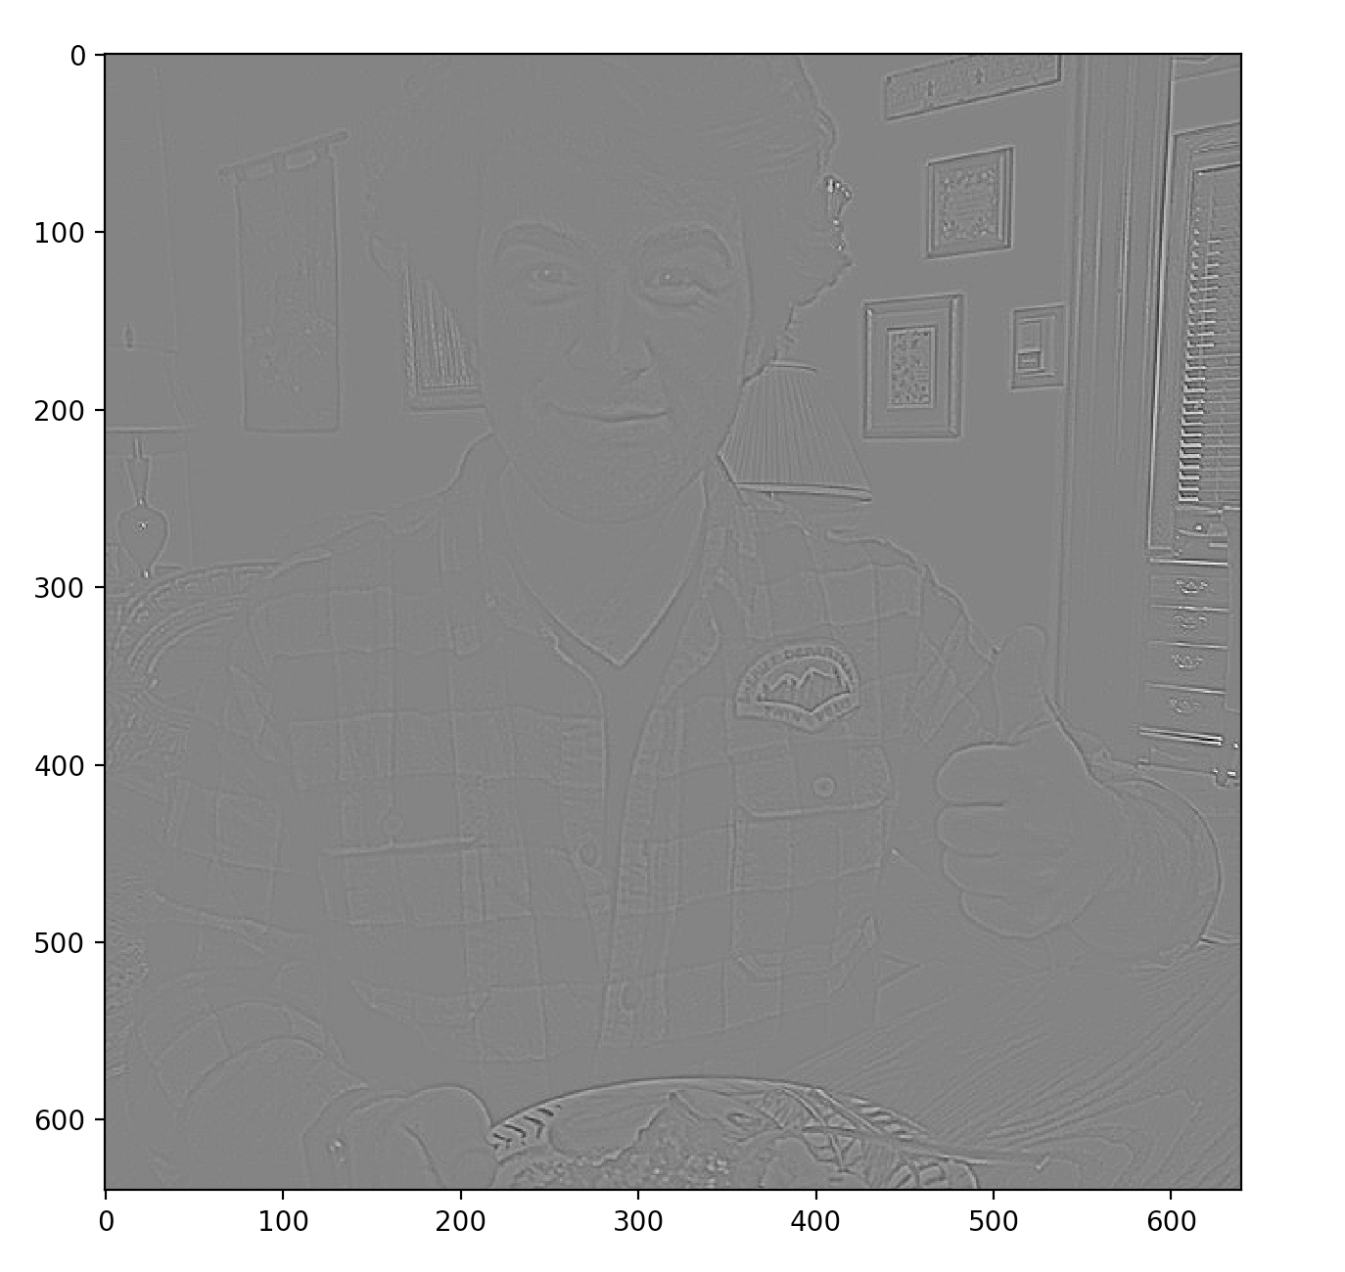
Example 1: ME
Pyr: 0

Slide 13
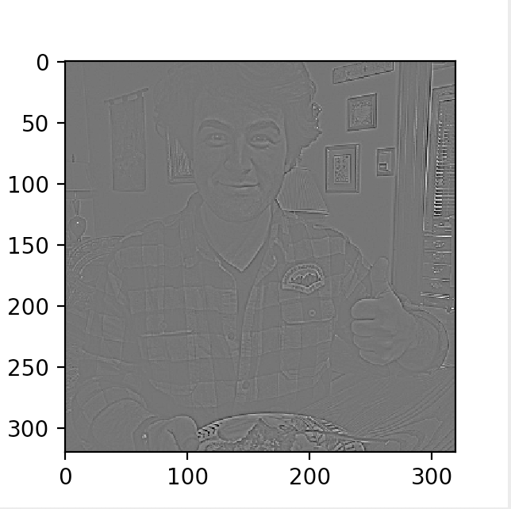
example 1: me
pyr: 1

Slide 14
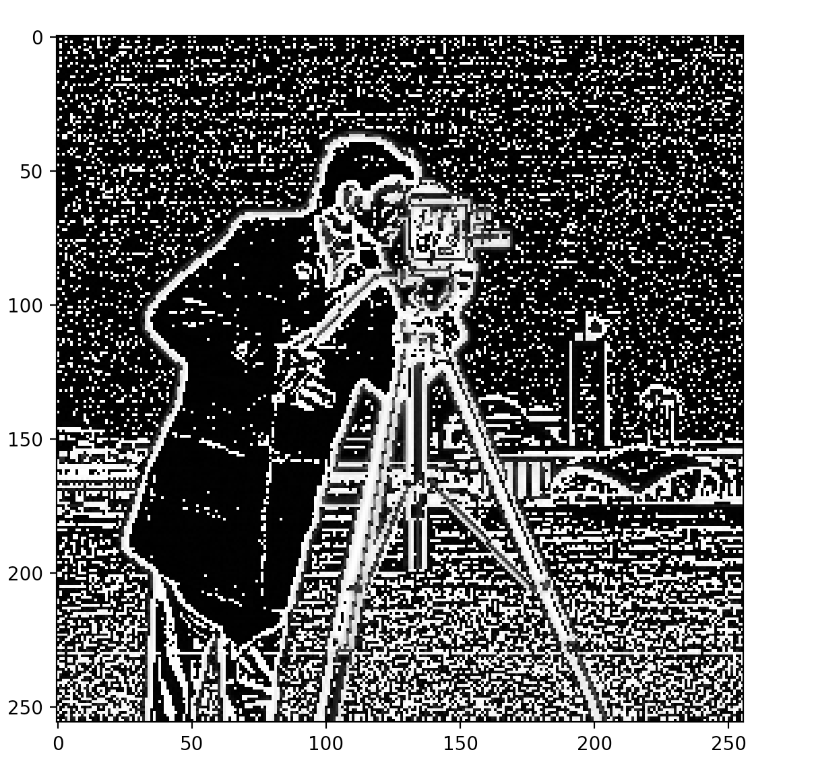
Example 2: Camera man
pyr: 0

Slide 15
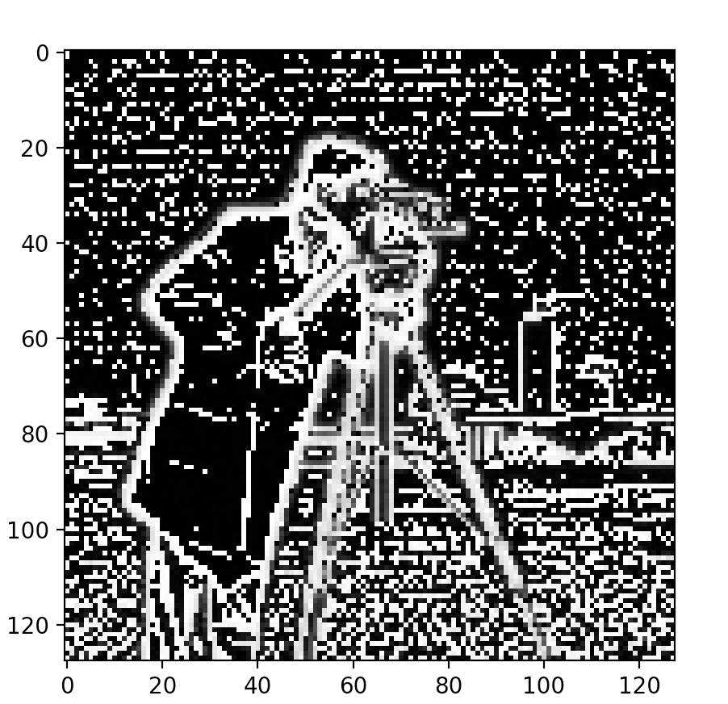
example 2: camera man
pyr: 1

Slide 16
laplacian Blending
Blend images together
Feathering
Mixing
Composite
Build Lap pyramids for both images
Build Gauss image from selected region
Form combined pyramid
Collapse to form new image

Slide 17
Example 1: Apple, Orange
Code: me/mathworks

Slide 18
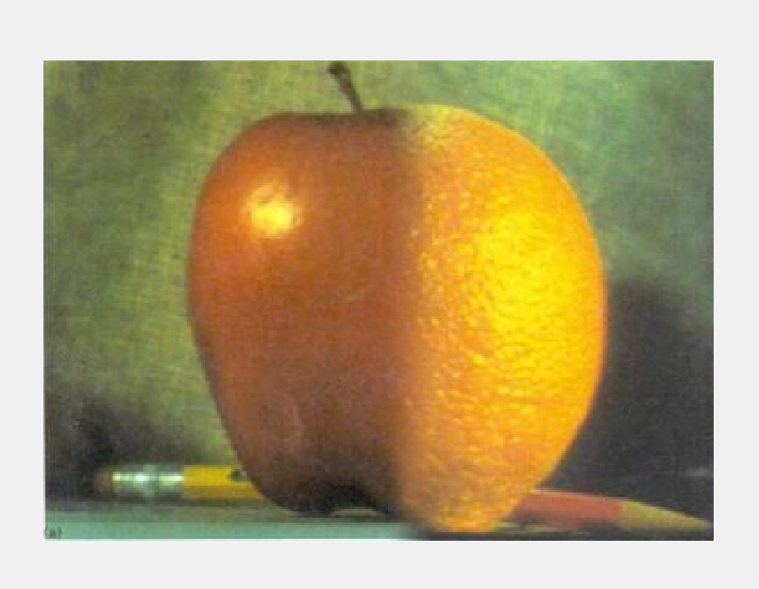
Example 1: result

Slide 19
Example 2: Apps
code: me/mathworks

Slide 20


Example 2: result

Slide 21
Example 3 Composite: me and Lisa
code: me/mathworks

Slide 22

Example 3 Composite: me and Lisa
Mask

Slide 23
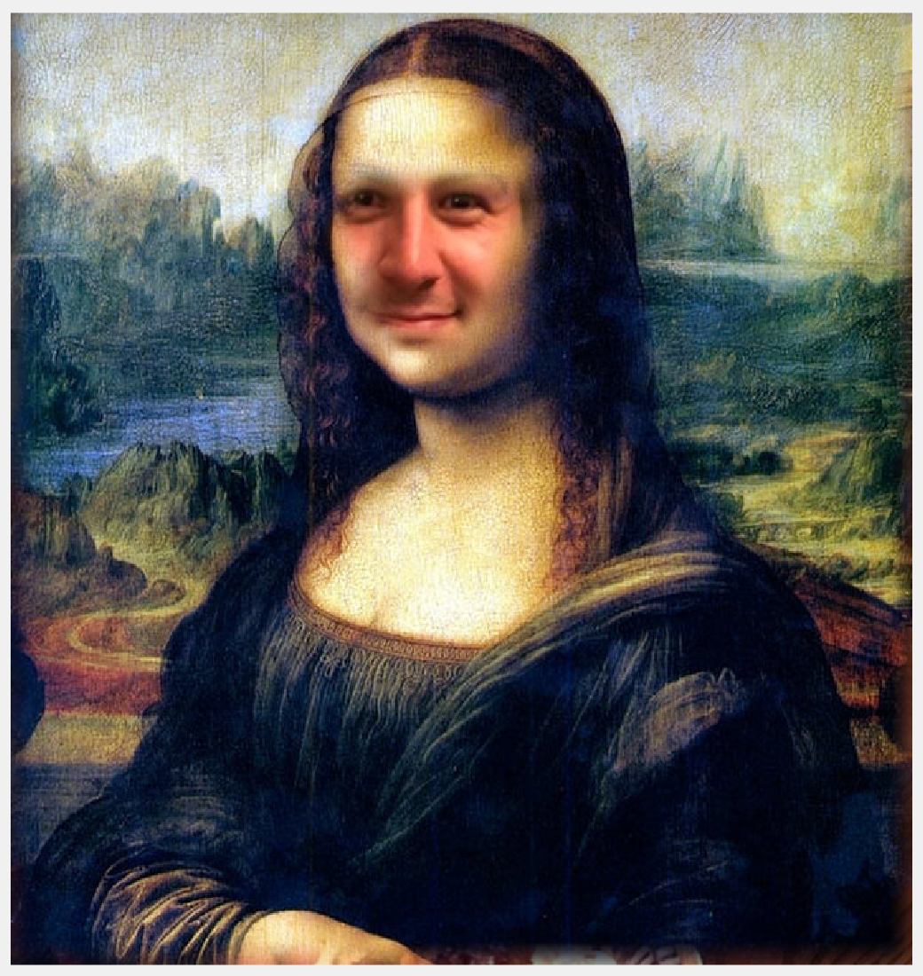
Example 3 Composite: me and Lisa
Result

Slide 24
Conclusions
Many of these techniques are very powerful
We used them every day without realizing
Large application now and in future

Slide 25
thank you

